Slide 1



MAP
2026
KNOWLEDGE INSTITUTE OF TECHNOLOGY, SALEM – 637504
(Autonomous Institution)
PORTABLE CUTTING MACHINE
CLUB NAME : SUSTANABLE ENGINEERING CLUB :
TEAM MEMBERS : GURU PRASANNA V , KARTHI VS ,KARTHICK SS , BRAJEETH G , THIRAGANTH J .
Full Affiliation: III – MECHANICAL
Name of the Mentor: MR.KN.KARTHICK
Presentation Date: 29.07.2025
05-05-2026
MAP 2025
1

Slide 2
ABSTRACT
This project belongs to the domains of Mechanical Engineering, Agricultural Automation, and Highway Infrastructure Maintenance. India has over 63 lakh kilometres of road network, and a significant portion requires regular vegetation management. Overgrown plants and shrubs along roadsides reduce driver visibility, damage road structures, and pose serious safety hazards. Traditional manual methods of cutting are slow, labour-intensive, and expose workers to traffic-related dangers. This project addresses the need for a mechanised, portable, and cost-effective solution that can be operated by a single person, reducing dependency on large labour teams while improving efficiency and worker safety.

Slide 3
PROBLEM STATEMENT
National Highways Authority of India (NHAI) - responsible for maintenance of over 1.5 lakh km of national highways requiring regular vegetation control
State Public Works Departments (PWD) - managing state and district roads in Tamil Nadu and other states, requiring affordable and portable cutting equipment
Road Maintenance Contractors and Subcontractors - private firms awarded highway upkeep contracts who need low-cost mechanised tools to improve operational efficiency
Smart City Projects and Municipal Corporations - urban local bodies managing roadside greenery in cities and peri-urban corridors seeking scalable automation solutions

Slide 4
PROPOSED SOLUTION
The specific problem selected is the absence of a portable, affordable, and easy-to-operate mechanised plant cutting machine suitable for roadside use in India
Existing imported machinery (tractor-mounted mowers) costs Rs. 5-15 lakhs and is impractical for narrow rural roads; no affordable Indian-made alternative exists in the Rs. 3,000-5,000 range
Rationale for selection - this problem has direct social impact (road safety), economic impact (reduced labour cost), and strong market demand across Tamil Nadu’s 2 lakh km of state and district roads
Customer-fit confirmation - all 7 customers interviewed (workers, supervisors, and PWD contractor) rated the need for such a machine as “high priority” and expressed willingness to adopt it if priced below Rs. 5,000
This problem aligns with the team’s domain expertise in Mechanical Engineering, making us well-positioned to design, fabricate, and validate a working prototype within our academic timeline

Slide 5
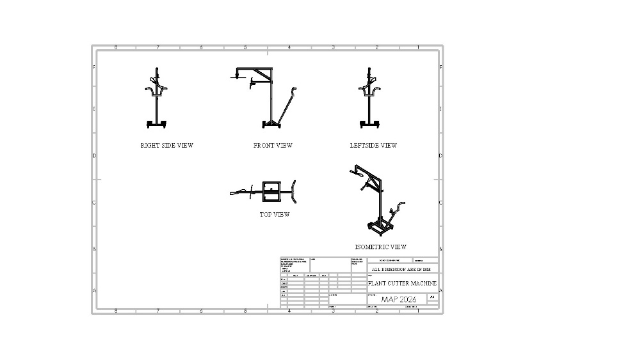
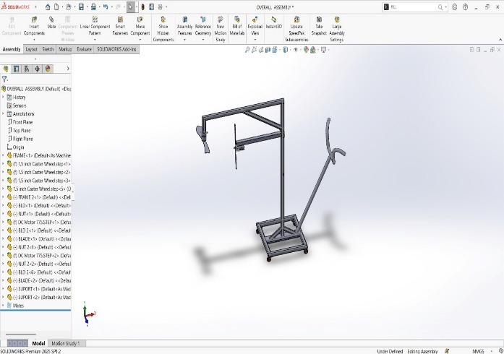
DESIGN AND COMPONENTS
Frame fabrication: 30mm x 30mm mild steel square tubes were cut and welded to form the trolley base (1200mm x 750mm). The frame was designed with cross-bracing for rigidity and coated with anti-rust paint. Total weight of frame: 4.2 kg
Motor and blade assembly: The 12vDC motor was mounted on the telescopic arm head using an aluminium motor bracket. The2-blade cutting disc was coupled directly to the motor shaft using a flange nut. Blade tip speed achieved: 28 m/s at full load
Power supply and wiring: 12V 10A battery housed in a lockable enclosure on the trolley shelf. ON/OFF switch installed in series. Endurance test: continuous cutting successfully achieved

Slide 6
OUTCOME OF THE PROJECT
Speed: Field test showed the machine cuts at 180 metres per hour on grass and small shrubs, compared to 50 metres per hour by a manual worker — a 3.6x improvement in productivity that directly reduces the time roads are exposed to maintenance hazards
Manpower reduction: 1 operator with the machine replaces a team of 6-8 manual cutters for the same stretch length per day. Based on a daily wage of Rs. 450 per worker, this saves Rs. 2,250 to Rs. 3,150 per day — the machine pays back its cost in under 10 working days
Safety: The extended-reach arm keeps the operator on the footpath or road shoulder at all times. The dead-man safety switch, blade guard, and no-fuel design (battery-powered) eliminate fire risk, fuel spillage, and exhaust exposure, making this significantly safer than petrol-powered brush cutters

Slide 7
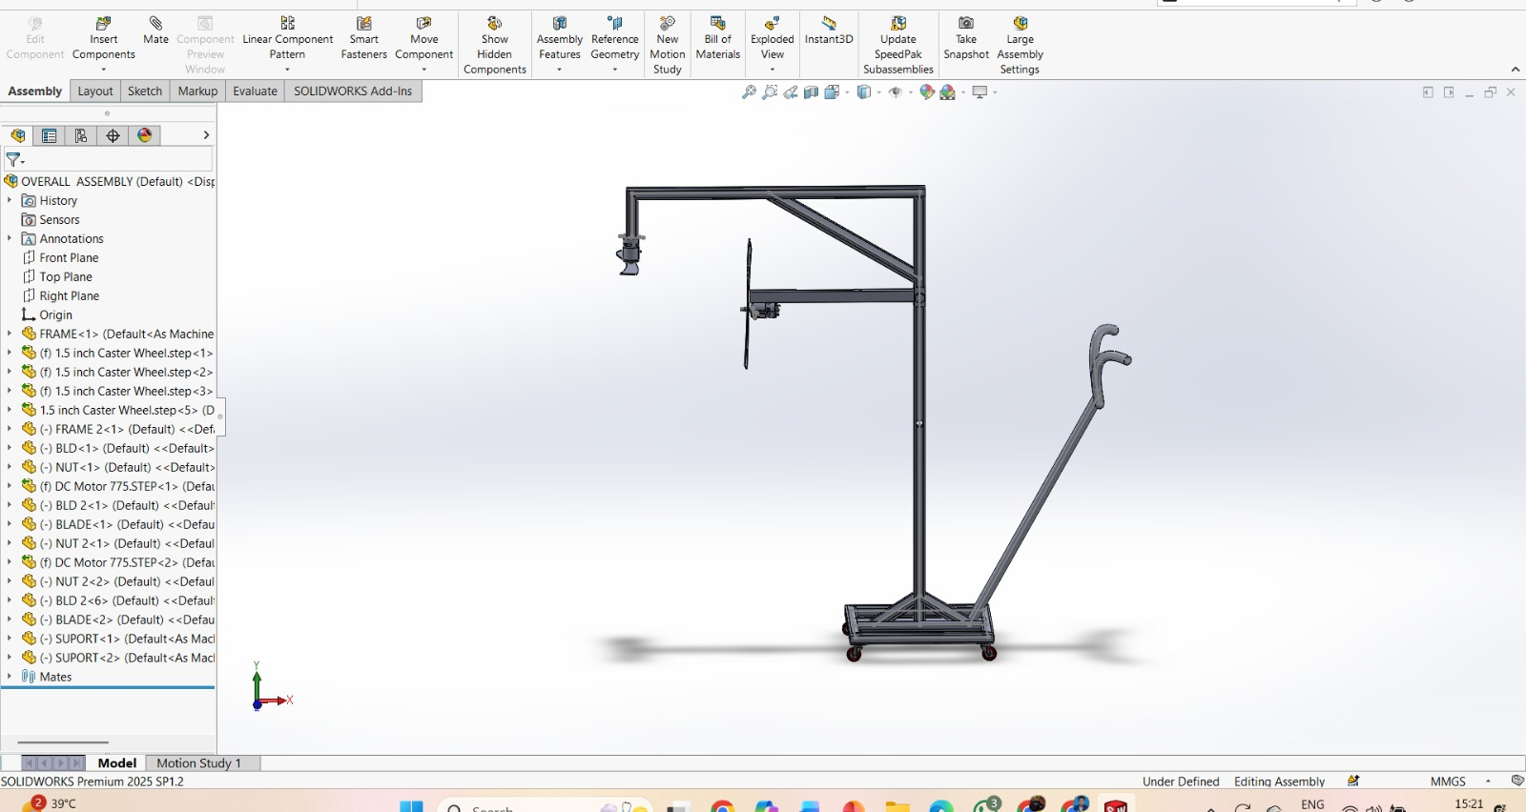
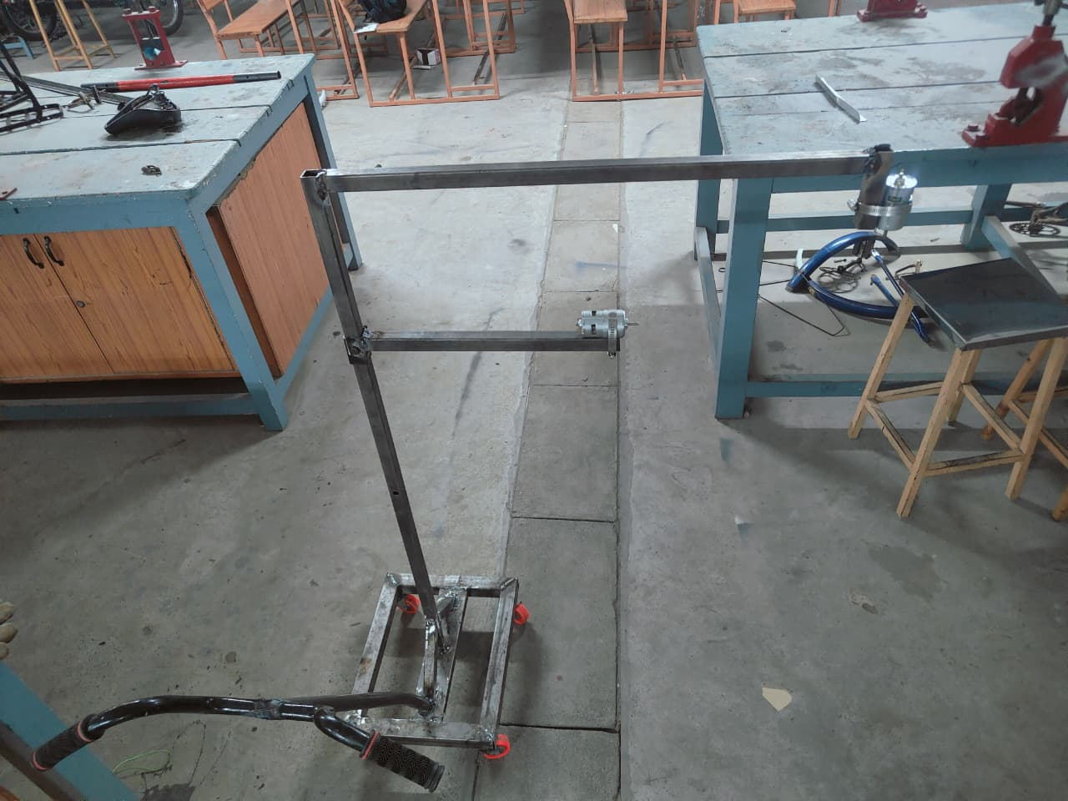
CONCLUSION & FUTURE SCOPE

